Slide 1
Notice Writing
Format

Slide 2
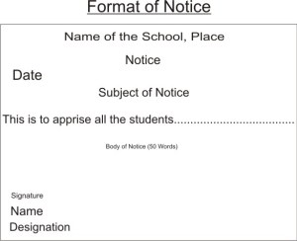
FORMAT
FORMAT – 1 MARK
CONTENT – 2 MARK
EXPRESSION – 1 MARK
TOTAL - 4 MARKS

